Slide 1
DreamTX
Understanding the JavaScript Event Loop

Slide 3
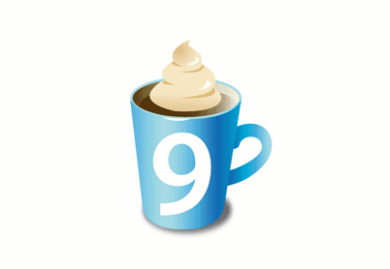






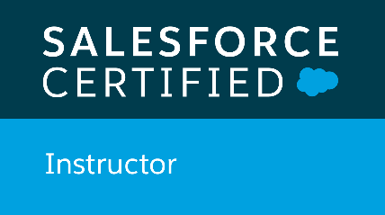

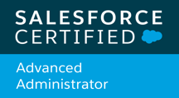
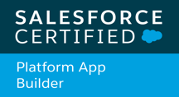
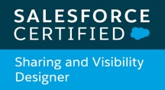
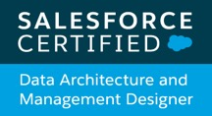

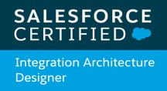


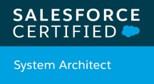
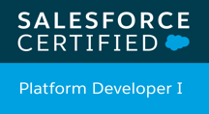
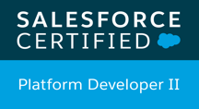
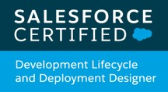
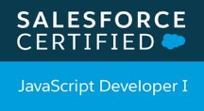


Andrés Pérez
Global Principal Technical Instructor
ELTOROIT
Notes:
=== Copyright Images
Flag: https://en.wikipedia.org/wiki/Flag_of_Canada
TH Ranks: https://org62.lightning.force.com/lightning/r/ContentDocument/0690M000007Ni5wQAC/view

Slide 4
Agenda
JavaScript is what...?
Can you show us some code?
What would a flowchart look like?
Why do I care?
Q & A

Slide 5
JavaScript is what...?

Slide 6
Can JavaScript Execute Multiple Tasks Simultaneously?
Let’s define some terms
Task: Smallest sequence of instructions executed independently
A task runs inside a thread
Thread
Task

Slide 7
Can JavaScript Execute Multiple Tasks “Simultaneously”?
Let’s define some terms
Single-Thread applications
Tasks execute in sequence
New task can ONLY start after previous one completes
Tasks should take turns
Appears to be simultaneous (Concurrent)
Easier to code

Slide 8
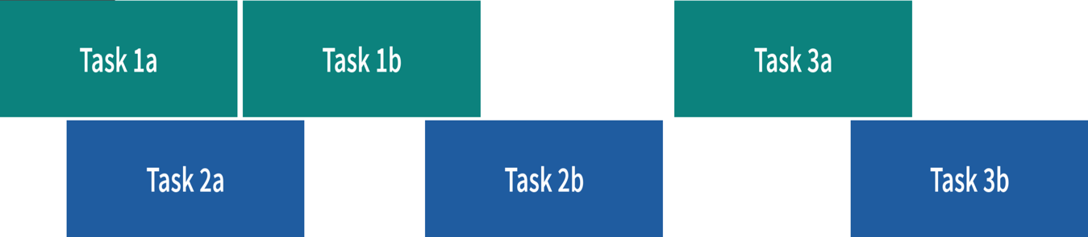
Can JavaScript Execute Multiple Tasks “Simultaneously”?
Let’s define some terms
Multi-thread applications
Tasks may execute in parallel
Task can start before previous one completes
Task may need to wait for other tasks to complete
Harder to code (synchronization)

Slide 9
What about JavaScript?
Synchronous? Asynchronous? Single-thread? Multi-thread?
JavaScript is like a pizza restaurant!
Notes:
=== Copyright Images
https://stock.adobe.com/ca/64369381
https://salesforce.widencollective.com/dam/assetdetails/asset:273ce00d-a7ec-472d-b8f1-eff81801772f/false?inav=false

Slide 10
Is JavaScript Single-Threaded?
Yes, it only performs one single task at a time
Ordering pizza at the counter
Stand in line at the counter until you can order pizza
Place your order without being interrupted
Sit down at the table and wait for the server to bring the pizza
What does it have to do with JavaScript?
This is very similar to the code you write
Being single-thread makes your code simple to write.
No need to worry about sharing resources
Browser executes your code when it’s ready.
Your code runs to completion, without being interrupted
Unless you want to wait…
Easier to write!

Slide 11
Can JavaScript Block Other Tasks?
But, what does blocking mean?
Imaging if ordering pizza was a single-threaded blocking process
Customer walks up to the counter
Places the order (at the counter)
Waits for the food (at the counter)
Eats (at the counter)
Pays for the pizza (at the counter)
Leaves the restaurant
Next customer can be served
What’s wrong with this?
Customers would have to wait forever to eat
The queue would get out of control
Tasks should take turns, especially long running ones!
“Please wait at the table, we’ll bring the pizza to you”

Slide 12
I Thought JavaScript Was Multi-Threaded!
It sure feels that way…
The trick is…
The browser!
Restaurant manager worries about
Keeping the customer queue organized
Processing many pizza orders per night
Serving the food efficiently
What does it have to do with JavaScript?
Browser manages the queues
Browser runs multiple tasks
This is hard to write, but luckily we are not writing the browser!

Slide 13
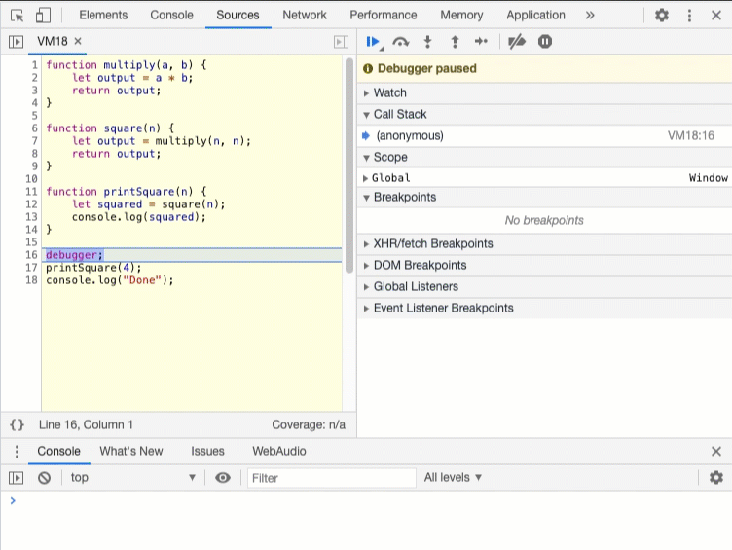
JavaScript Is…
Single-threaded
Synchronous
Blocking

Slide 14
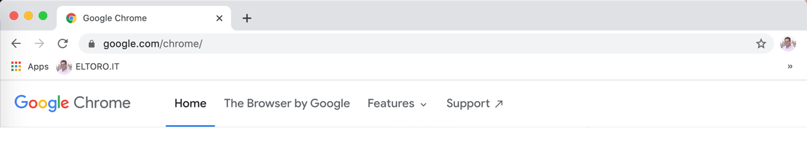

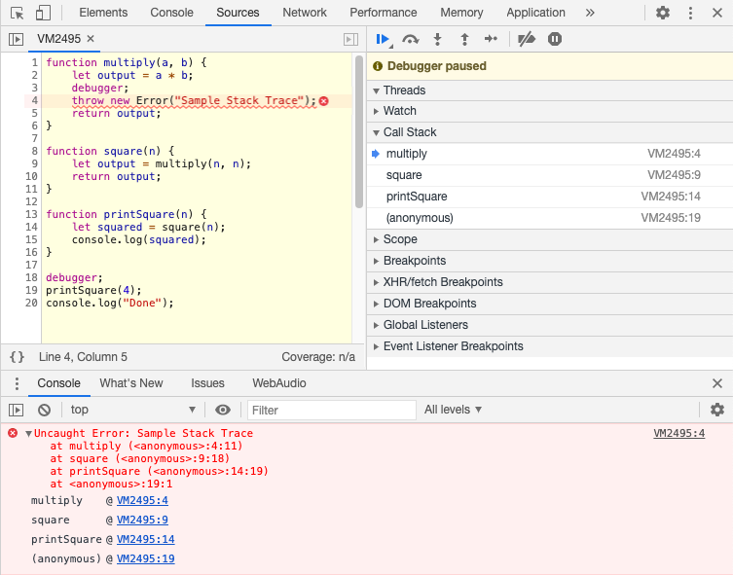

But, That’s Horrible!
Agree, but the JavaScript Engine is more than just the JavaScript language
Heap
Stack
Notes:
Stack: LIFO data structure which keeps track of the sequence in which functions are being called
Call Stack: https://en.wikipedia.org/wiki/Call_stack
LIFO structure
Stores information about the active subroutines of a computer program
AKA: execution stack, program stack, control stack, run-time stack, or machine stack, "the stack".
=== Copyright Images
https://commons.wikimedia.org/wiki/File:JavaScript-logo.png
https://commons.wikimedia.org/wiki/File:V8_JavaScript_engine_logo_2.svg
Loop: SLDS icon: Loop

Slide 15
But, That’s Horrible!
Agree, but the JavaScript Engine is more than just the JavaScript language
But the browser is
a lot more…
Heap
Stack
Notes:
Stack: LIFO data structure which keeps track of the sequence in which functions are being called
Call Stack: https://en.wikipedia.org/wiki/Call_stack
LIFO structure
Stores information about the active subroutines of a computer program
AKA: execution stack, program stack, control stack, run-time stack, or machine stack, "the stack".
=== Copyright Images
https://commons.wikimedia.org/wiki/File:JavaScript-logo.png
https://commons.wikimedia.org/wiki/File:V8_JavaScript_engine_logo_2.svg
Loop: SLDS icon: Loop

Slide 16

But, That’s Horrible!
Agree, but the JavaScript Engine is more than just JavaScript language
Web APIs
DOM Events
XMLHttpRequest (fetch)
Timer (setTimeout, setInterval)
Promise
…
Heap
Stack
Queues
Task
Task
Task
Task
Event Loop
Microtask
Notes:
Microtasks:
MutationObserver
Promise.then() and Promise.catch()
V8 garbage collection process
NodeJs process.nextTick()
Macrotasks:
setTimeout, setInterval, setImmediate
I/O
Notes:
dispatchEvent(new CustomEvent()) is synchronous.
=== Reference:
https://developer.mozilla.org/en-US/docs/Web/API/HTML_DOM_API/Microtask_guide
Prefer `queueMicrotask(()=>{})` over `Promise.resolve().then(()=>{})`
(if Available: https://developer.mozilla.org/en-US/docs/Web/API/WindowOrWorkerGlobalScope/queueMicrotask)
https://developer.mozilla.org/en-US/docs/Web/API/HTML_DOM_API/Microtask_guide/In_depth
Several windows loaded from the same origin may be running on the same event loop,
https://developer.mozilla.org/en-US/docs/Web/JavaScript/EventLoop
setTimeout: The time value represents the (minimum) delay after which the message will be pushed into the queue.
https://developer.mozilla.org/en-US/docs/Learn/JavaScript/Asynchronous/Timeouts_and_intervals
setTimeout() vs setInterval()
setInterval(): The interval you chose includes the time taken to execute the code you want to run in. Let's say that the code takes 40 milliseconds to run — the interval then ends up being only 60 milliseconds.
https://developer.mozilla.org/en-US/docs/Web/JavaScript/Guide/Using_promises
A promise is a returned object to which you attach callbacks, instead of passing callbacks into a function.
p.then(onFulfilled[, onRejected]);
catch(failureCallback) is short for then(null, failureCallback)
https://developer.mozilla.org/en-US/docs/Web/JavaScript/Reference/Global_Objects/Promise/then
https://developer.mozilla.org/en-US/docs/Learn/JavaScript/Asynchronous/Choosing_the_right_approach
=== Copyright Images
https://commons.wikimedia.org/wiki/File:JavaScript-logo.png
https://commons.wikimedia.org/wiki/File:V8_JavaScript_engine_logo_2.svg
Loop: SLDS icon: Loop

Slide 17
Tasks? Microtasks?
Yes, they are different!
Microtasks include:
Promises (then, catch, resolve(), reject())
queueMicrotask()
MutationObserver
Task include:
Regular execution
<script>alert('Hello Moon!');</script>
Code run from the console
Event callbacks
Timers (setTimeout(), setInterval())
Microtasks have precedence over tasks
Runs until microtask queue is empty
Including new microtasks queued during the current Event Loop cycle
This could block the execution!

Slide 18
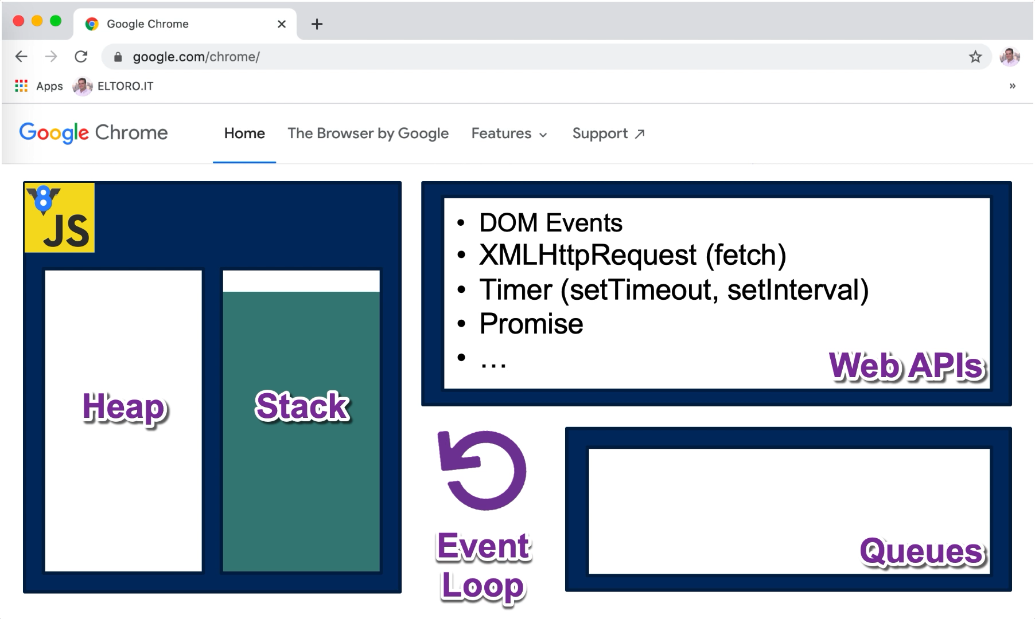
What Does The Event Loop Do?
Stack
Orchestration!

Slide 19
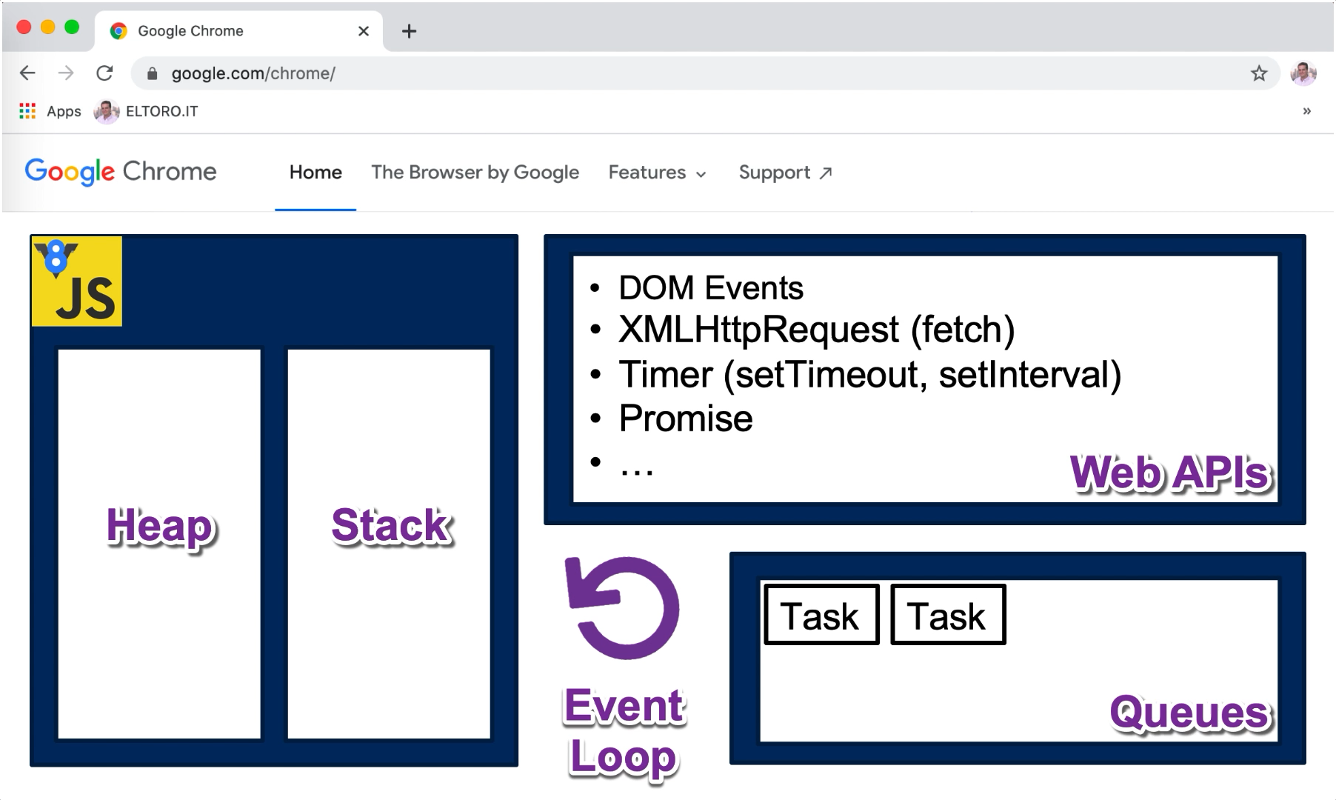
What Does The Event Loop Do?
Task
Orchestration!

Slide 20
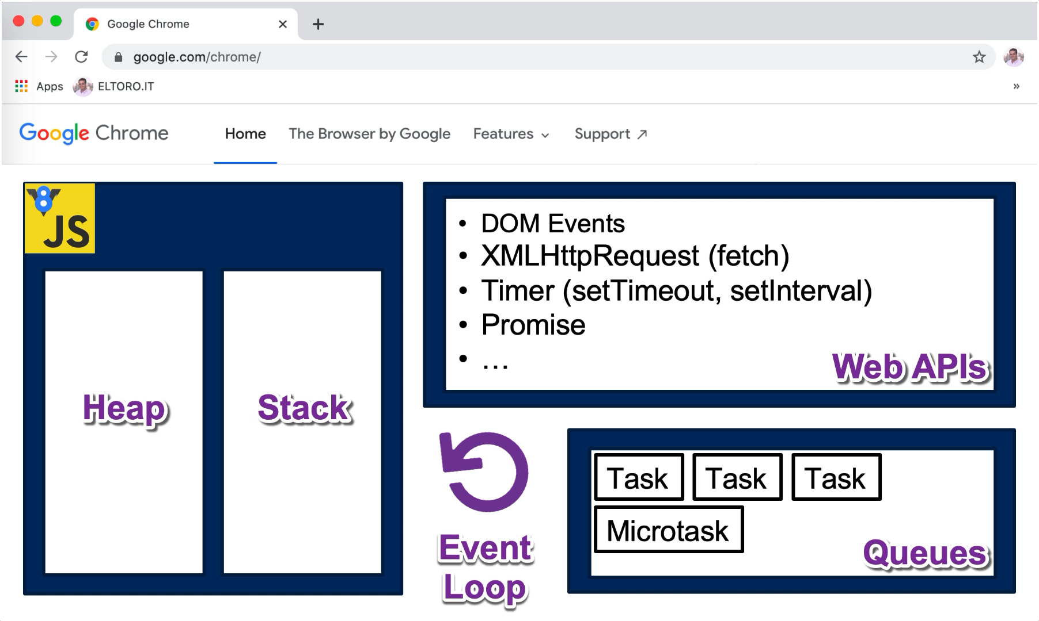
What Does The Event Loop Do?
Microtasks
Orchestration!

Slide 21
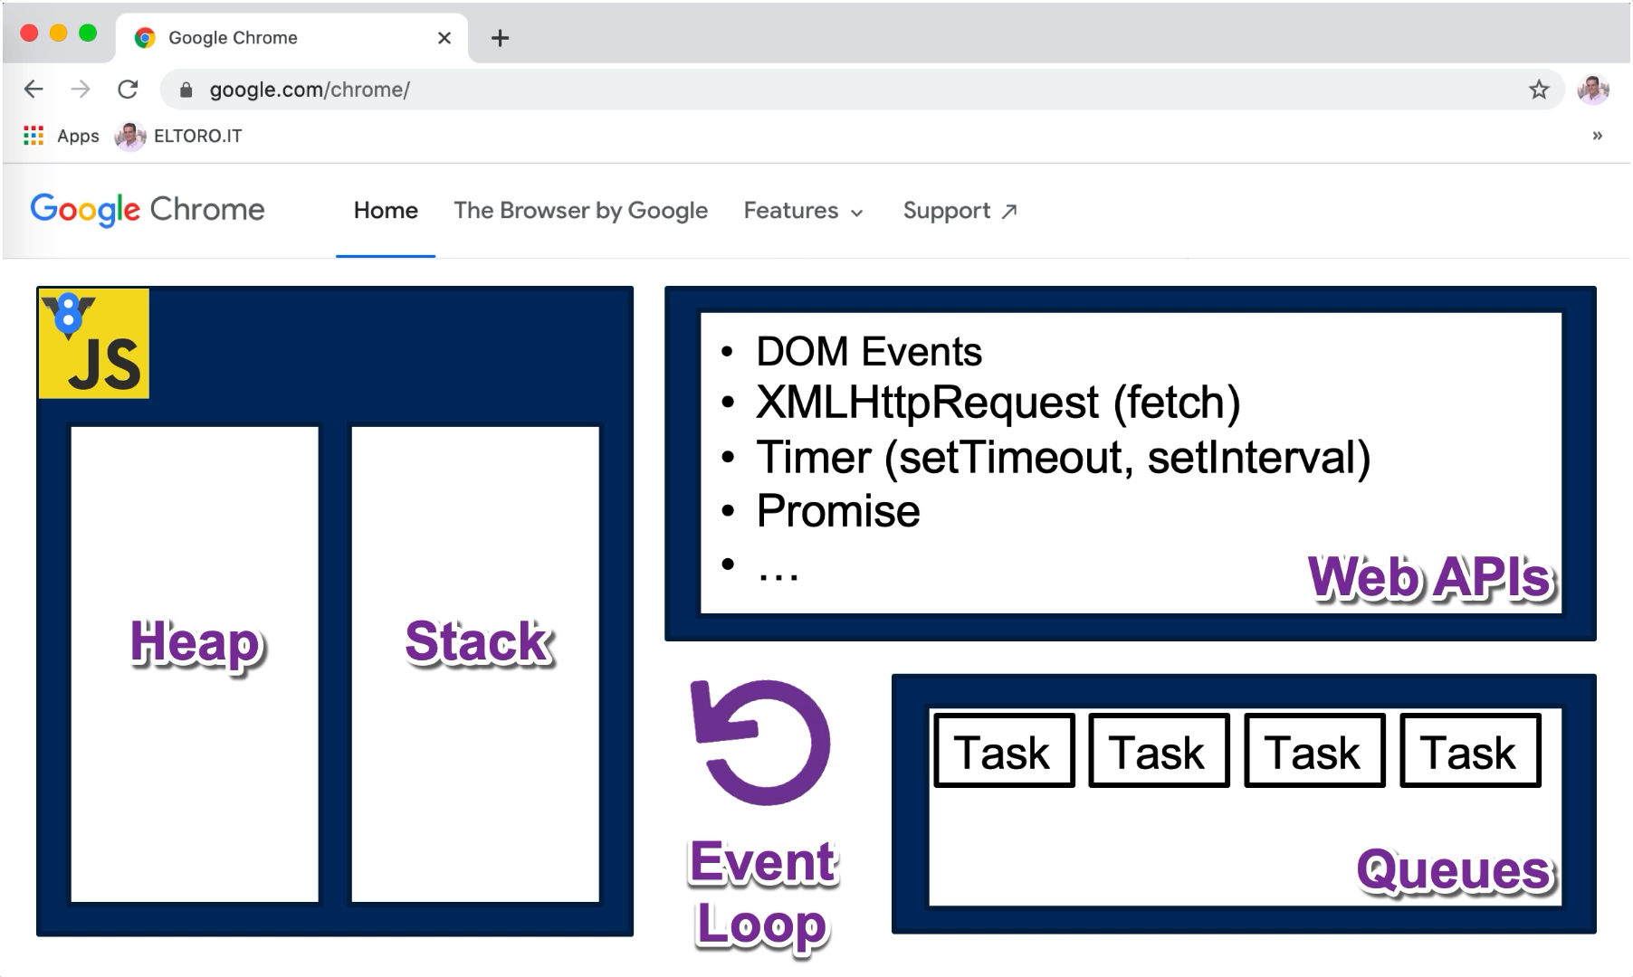
What Does The Event Loop Do?
All Tasks
Orchestration!

Slide 22
Can you show us some code?
https://etEventLoop.herokuapp.com/

Slide 23
What would a flowchart look like?

Slide 24
Title
While true
JavaScript Event Loop @ELTOROIT https://etEventLoop.herokuapp.com/

Slide 25
Execute Task
While true
JavaScript Event Loop @ELTOROIT https://etEventLoop.herokuapp.com/
Only one task is executed
Any task?
Yes
No
Execute oldest task

Slide 26
Execute Microtask
While true
JavaScript Event Loop @ELTOROIT https://etEventLoop.herokuapp.com/
Only one task is executed
Any task?
Yes
No
Execute oldest task
Microtask queue empty?
Yes
No
Execute oldest microtask
Execute every microtask (including new ones)

Slide 27
Repaint
While true
JavaScript Event Loop @ELTOROIT https://etEventLoop.herokuapp.com/
Only one task is executed
Any task?
Yes
No
Execute oldest task
Assuming 60 frames per second (about every 16 ms)
Microtask queue empty?
Time to repaint?
Yes
Yes
Repaint screen
No
No
Execute oldest microtask
Execute every microtask (including new ones)

Slide 28
Why do I care?
https://etEventLoop.herokuapp.com/

Slide 29

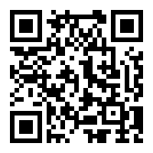

Q&A TIME!
TAKE OUR SURVEY!
*link in chat window*
https://www.surveymonkey.com/r/DreamTX
Ask your questions in the Chat Window!

